Slide 1
Version Control

Slide 2
Today’s agenda
Three sessions, each consisting of an initial presentation followed by a practical session.
Introduction to version control
What it is and the benefits it provides
Basic version control on your local pc
Remote hosting
Putting your version control on a remote host
Using NERC Github account
Team working
Working together on a set of files
Resolving conflicts
Extras and more advanced topics

Slide 3
Session 1. Introduction to version control
‘Version control is a system that records changes to a file or set of files over time so that you can recall specific versions later’

Slide 4
What do you want from version control?
Recovery
Reproducibility
Track changes
Audit and Traceability
Funding requirement
Safety and resilience
Collaboration
Experiments on code
Notes:
Fits into Quality control
Recover
Audit
Resilient
Easy to use
Unobtrusive
- fast
- efficient at storing changes (doesn’t eat up storage)
- does not impose a way of working
Does not lock files being edited – ie no one is blocked from editing a file
Platform independent
Well supported (mature forums and tutorials)

Slide 5
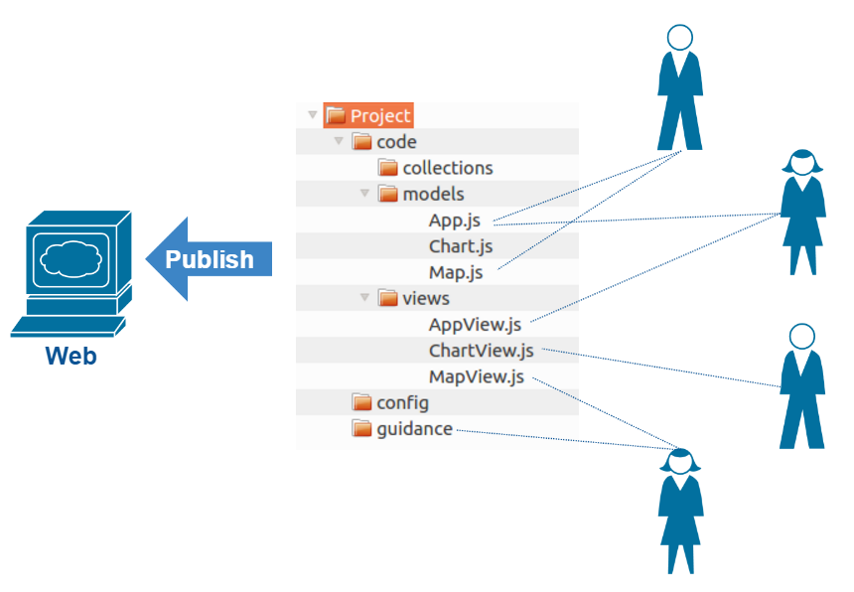
Typical scenario in our group

Slide 6
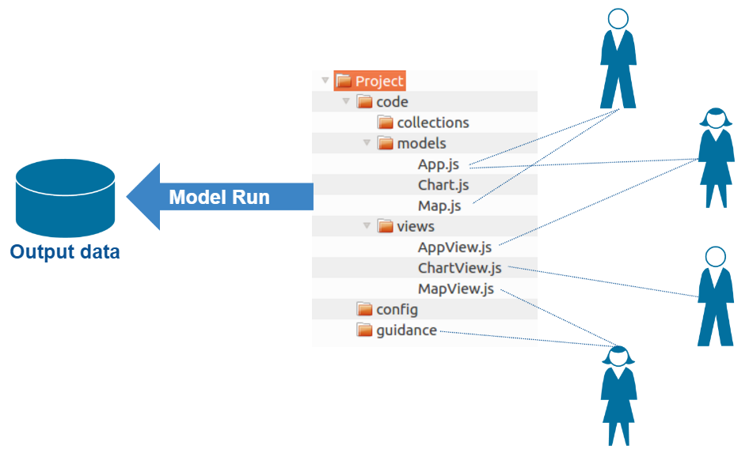
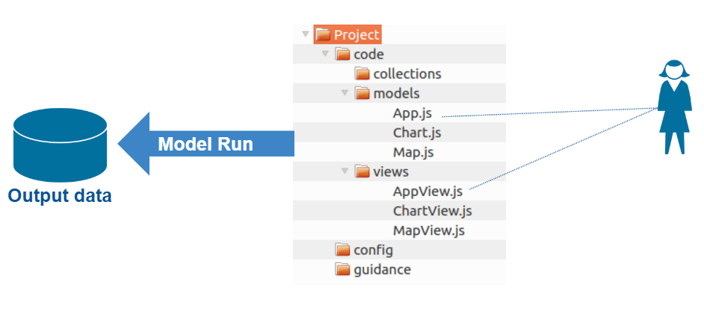
Typical scenario with a model run?

Slide 7
Notes:
‘By far, the most widely used modern version control system in the world today is Git’
Lightweight and easy to install
Very fast, partly because almost all operations are local
Does not depend on centralised server
Has become integrated into many tools
Once you understand the principles you can easily use it when you find it embedded in your tools
Mature
Actively maintained
Fast
Works on many operating systems
Highly flexible – from tiny to large projects, individual use to many users

Slide 8
A couple of good learning resources
Great free book: https://git-scm.com/book/en/v2
Excellent Atlassian tutorial: https://www.atlassian.com/git/tutorials/what-is-version-control

Slide 9
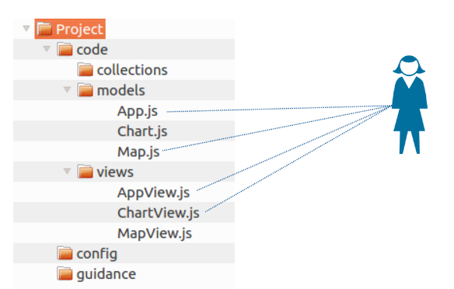
Session 1: Principles
Version control a set of files on my local drive
Notes:
Encourages organising work in project folder

Slide 10
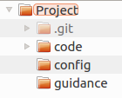
Session 1: Principles
Add Git to your project
Your project
Git
repository
added
Enable Git
Notes:
Git repository Is part of the project
It is in the root of the project
Local – therefore no need to be online to get on with work and it is fast

Slide 11
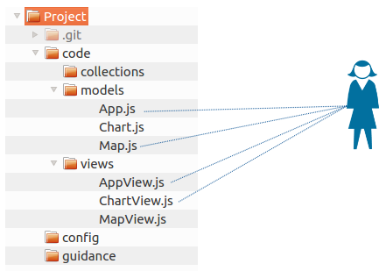
Session 1: Principles
After editing project files, save your changes to Git
This is called Committing
Git does not automatically save your changes
Committing records who did what when
Commit
Edits

Slide 12
Session 1: Principles
Committing is a two step process:
1. Choose the changes you want in the commit – called Staging
2. Do the Commit
AppView.js
MapView.js
2. Commit
1. Stage
Edits

Slide 13
Session 1: Principles
App.js
Stage file
Edits

Slide 14
Session 1: Principles
Staged file
App.js
Edits

Slide 15
Session 1: Principles
App.js
Map.js
Stage file
Edits

Slide 16
Session 1: Principles
Staged files
App.js
Map.js
Edits

Slide 17
Session 1: Principles
Commit log
Commit
“Added title”
App.js
Map.js
1 Added title Jon 01-04-2017 13:42
Edits

Slide 18
Session 1: Principles
Commit log
AppView.js
MapView.js
1 Added title Jon 01-04-2017 13:42
Stage files
Edits

Slide 19
Session 1: Principles
AppView.js
MapView.js
Commit log
Commit
“Added button”
App.js
Map.js
1 Added title Jon 01-04-2017 13:42
2 Added button Jon 01-04-2017 14:47
Edits

Slide 20
Session 1: Principles
Commit
“Changed style”
AppView.js
MapView.js
Commit log
1 Added title Jon 01-04-2017 13:42
2 Added button Jon 01-04-2017 14:47
Stage all files
3 Changed style Jon 01-04-2017 15:23
Edit
Edit
Edit
Edit

Slide 21
Session 1: Principles
Commit
“Added slider”
AppView.js
MapView.js
Commit log
1 Added title Jon 01-04-2017 13:42
2 Added button Jon 01-04-2017 14:47
Stage files
3 Changed style Jon 01-04-2017 15:23
4 Added slider Jon 03-04-2017 08:32
Edit
Edit
Edit
Edit

Slide 22
Session 1: Principles
Commit
“Fixed data”
AppView.js
MapView.js
Commit log
1 Added title Jon 01-04-2017 13:42
2 Added button Jon 01-04-2017 14:47
Stage files
3 Changed style Jon 01-04-2017 15:23
4 Added slider Jon 03-04-2017 08:32
5 Fixed data Jon 03-04-2017 10:15
Edit
Edit
Edit
Edit

Slide 23
Session 1: Principles
Commit
“Downloads”
AppView.js
MapView.js
Commit log
1 Added title Jon 01-04-2017 13:42
2 Added button Jon 01-04-2017 14:47
Stage files
3 Changed style Jon 01-04-2017 15:23
4 Added slider Jon 03-04-2017 08:32
5 Fixed data Jon 03-04-2017 10:15
6 Downloads Jon 03-04-2017 10:15
Edit
Edit
Edit
Edit

Slide 24
Session 1: Principles
Commit
“Help panel”
AppView.js
MapView.js
Commit log
1 Added title Jon 01-04-2017 13:42
2 Added button Jon 01-04-2017 14:47
Stage files
3 Changed style Jon 01-04-2017 15:23
4 Added slider Jon 03-04-2017 08:32
5 Fixed data Jon 03-04-2017 10:15
6 Downloads Jon 03-04-2017 10:15
Edit
Edit
7 Help panel Jon 03-04-2017 13:27
Edit
Edit

Slide 25
Session 1: Principles
Commit log
1 Added title Jon 01-04-2017 13:42
Snapshot of files at each commit
Who did what when
Checkout previous version
2 Added button Jon 01-04-2017 14:47
3 Changed style Jon 01-04-2017 15:23
4 Added slider Jon 03-04-2017 08:32
5 Fixed data Jon 03-04-2017 10:15
6 Downloads Jon 03-04-2017 10:15
7 Help panel Jon 03-04-2017 13:27

Slide 26
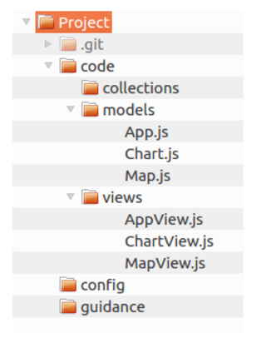
Session 1: Principles
All files as they were at commit 3
Commit log
1 Added title Jon 01-04-2017 13:42
Checkout
2 Added button Jon 01-04-2017 14:47
3 Changed style Jon 01-04-2017 15:23
4 Added slider Jon 03-04-2017 08:32
5 Fixed data Jon 03-04-2017 10:15
6 Downloads Jon 03-04-2017 10:15
7 Help panel Jon 03-04-2017 13:27
Working copy

Slide 27
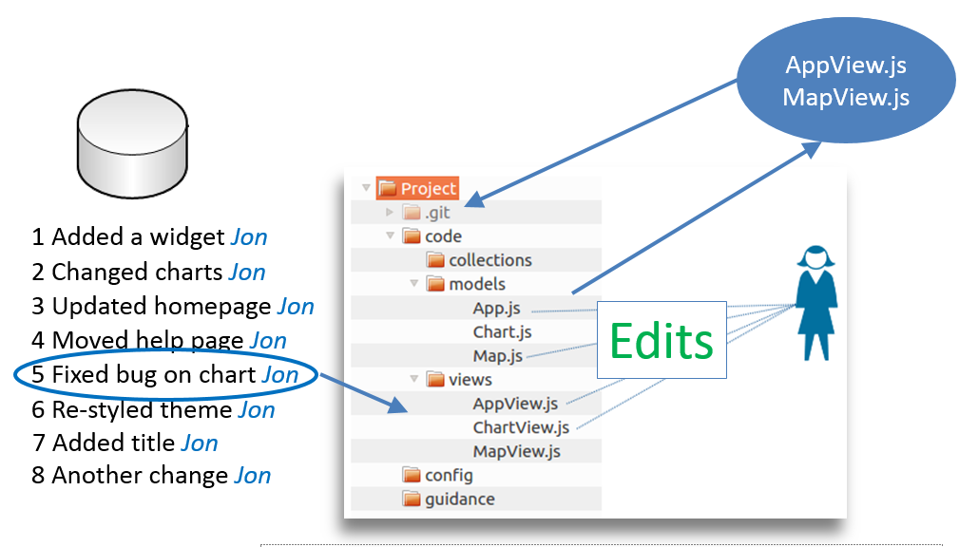
Session 1: Principles
1 Working copy
2 Git repository
3 Stage files
4 Commit files
5 Commit log
6 Checkout
4
3
5
2
6
1

Slide 28
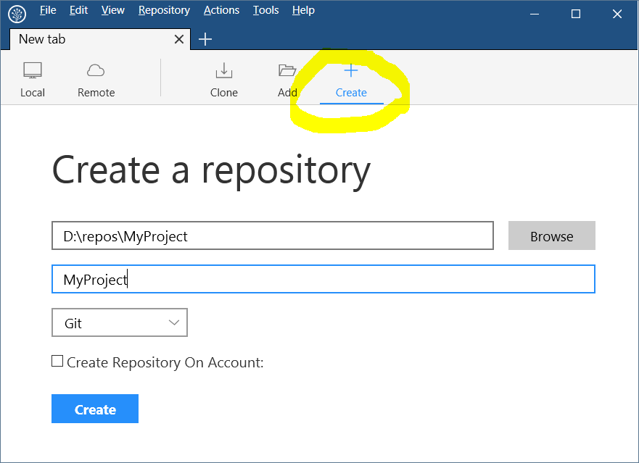
Session 1: Principles
All exercises use SourceTree
https://nerc-ceh.github.io/version_control/install_sourcetree_windows

Slide 29
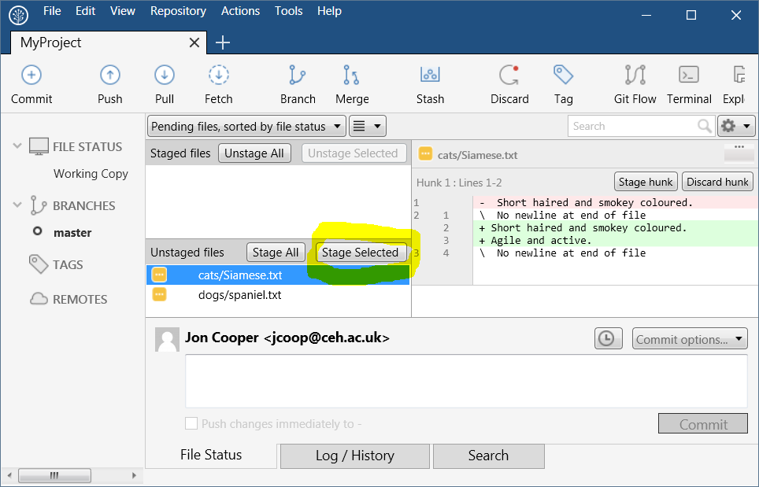
Session 1: Principles
Example of selecting files to stage in SourceTree

Slide 30
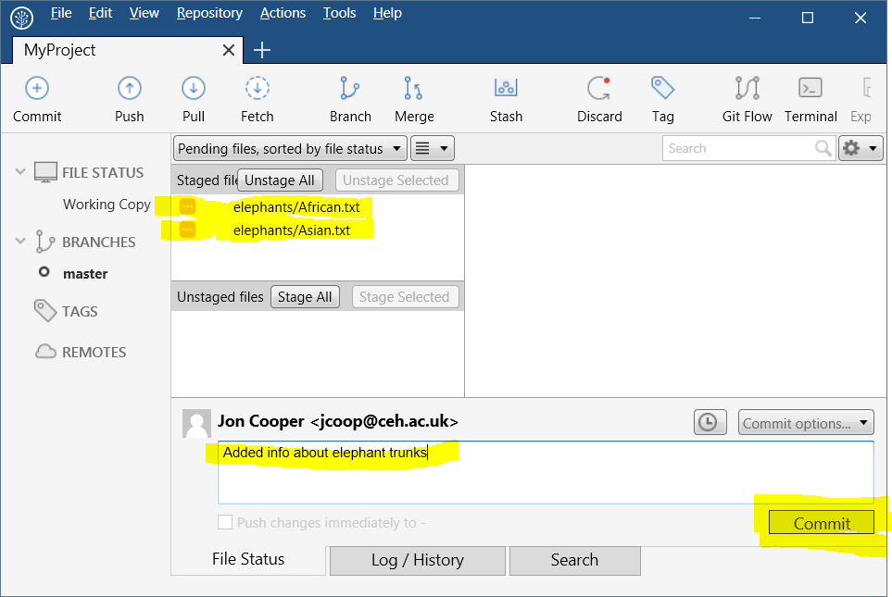
Session 1: Principles
Example of committing staged files

Slide 31
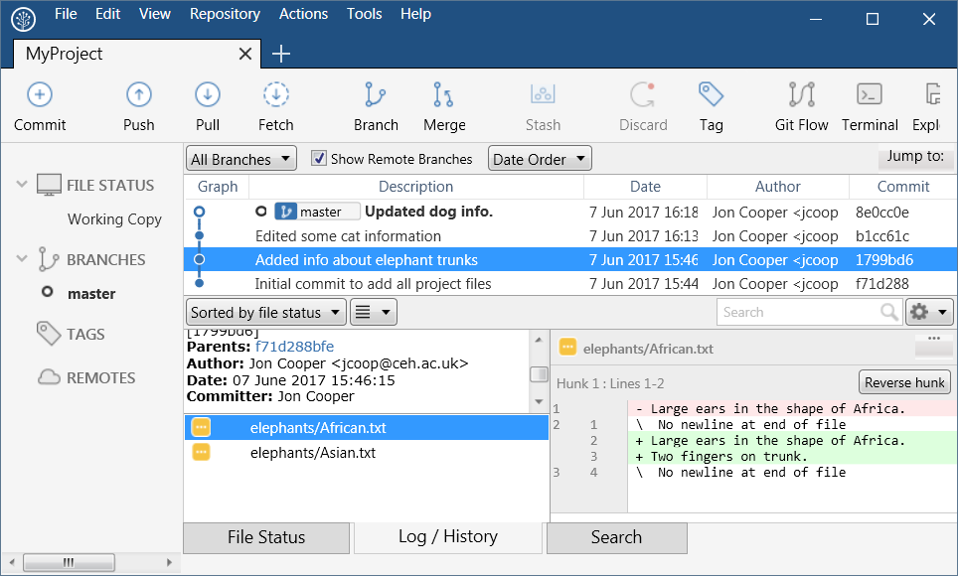
Session 1: Principles
Example of viewing the commit log

Slide 32
Session 1: Principles
Exercise 1
https://nerc-ceh.github.io/version_control/exercise1
Enable Git on a folder
Review the status of files in the folder
Repeatedly edit files and add your changes to Git
Review changes
Checkout a previous version of your changes
Apply a tag to a specific version for future reference
Exclude files from version control

Slide 33
Session 2: Remote repository
Others are available
Gitlab
Stash
Bitbucket
etc…
Github.com
Notes:
On-line access to repository
Simplifies collaboration

Slide 34
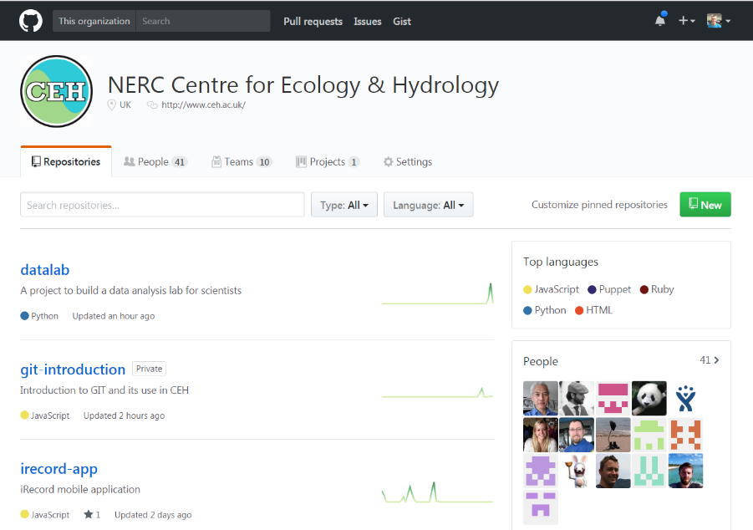
Session 2: Remote repository
Register with Github.com
Free for public and open source projects
Join the NERC-CEH organisation on Github for free CEH private projects
https://github.com/NERC-CEH

Slide 35
Session 2: Remote repository
Create empty repository on Github
Download a local copy – called Cloning
Work locally just as you did in session 1, committing your changes
Periodically synchronise with Github using Push and Pull

Slide 36
Session 2: Remote repository
Create repository on Github
Push commits to Github
Pull down commits from others
Clone to your computer
Commit locally
Notes:
On-line access to repository
Simplifies collaboration

Slide 37
Session 2: Remote repository
Exercise 2
https://nerc-ceh.github.io/version_control/exercise2
Register with Github
Join the NERC-CEH organisation
Create a repository in the NERC-CEH organisation
Clone it on local machine and commit changes
Push repository state to Github

Slide 38
Session 3: Team working

Slide 39
Session 3: Team working
Collaborating in Github
Branching and merging
Sharing changes
Conflict resolution
Pull requests and quality control

Slide 40
Session 3: Team working
Add collaborators to your private Github repository
Send invitation to collaborators via Github
Collaborators have Push (write) access to repository
More details here:
https://help.github.com/articles/inviting-collaborators-to-a-personal-repository

Slide 41
Session 3: Team working
Branching and merging
A Branch is a parallel line of development in repository
Keeps work off main branch until it is ready
Merging is the process of putting the changes on that branch back into the main branch

Slide 42
Session 3: Team working
Branching and merging
New branch
Main branch
Merge branch
New branch
Single commit

Slide 43
Session 3: Team working
Multiple people accessing one Github repository
Repository on Github
Clone,
Pull, Push
Clone,
Pull, Push
Person 1
Person 2
Checkout branch
Stage, Commit
Checkout branch, Stage, Commit
Notes:
On-line access to repository
Simplifies collaboration

Slide 44
Session 3: Team working
Conflict resolution
Two collaborators edit the same text in the same file
Person 1 Pushes their change to Github
Person 2 Pulls down changes and gets a Conflict
Person 2 cannot Push to Github until it is resolved
Conflict must be edited and marked as Resolved
Demonstrated in exercise
Merge tools available to help

Slide 45
Session 3: Team working
Pull Request
Pull Request is a Quality Assurance step around a Merge
Lets collaborators know a branch is ready to be merged into the main branch
Changes can be reviewed, discussed, altered, etc
Branch merged only when Pull Request is accepted

Slide 46
Session 3: Team working
Pull Request
Merge prevented until Pull Request accepted
New branch
Main branch
Merge branch
New branch
Single commit

Slide 47
Session 2: Team working
Exercise 3
https://nerc-ceh.github.io/version_control/exercise3
Invite collaborators to your repository
Work as a team on a new branch
Create and resolve conflicts
Issue and accept a pull request

Slide 48
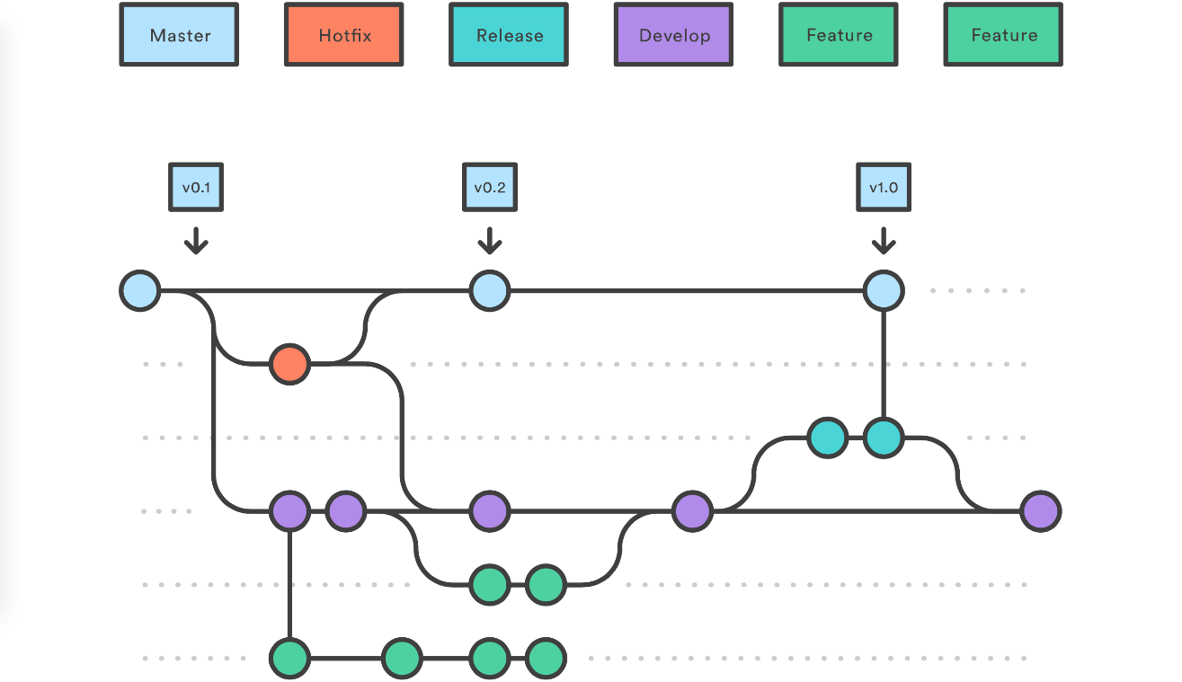
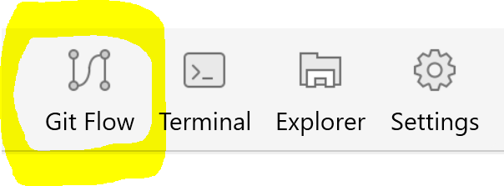
Workflows
Gitflow
Available in SourceTree:

Slide 49
More than just version control
Integrates with issue management
Branches matched to issues
Workflows triggered by commits, pull requests, etc
Automates unit and integration tests
Automates deployment to servers
Open sourcing
Promotes collaboration and quality
Increases reputation

Slide 50
SVN to GIT
To move from SVN to GIT without keeping history
Create new repository in github.com/NERC-CEH (exercise 2 step 2)
Clone it to your local drive (exercise 2 step 3)
Use SVN Export to get clean copy of your code from SVN into your new local git repository
Use git add, git commit and git push to get all those files into your github.com repository
Give your team members access to your new github repository (exercise 3 step 2)
Team members can now clone your repository and they are up and running in git

Slide 51
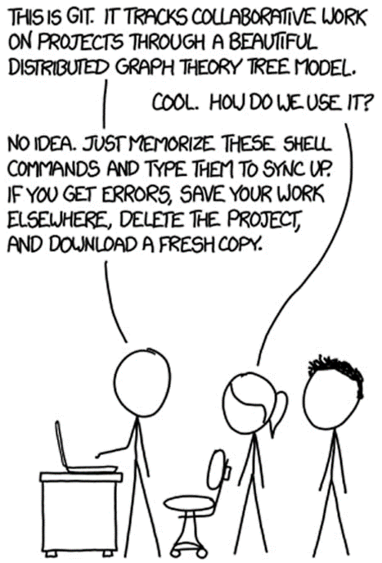
Cheat sheet
Git repository in a mess?
Rename the root folder
Clone a new copy from github.com
With original files to help, make edits to files in new repo
Delete original when happy
git clone
git checkout
git add
git commit
git pull
git push
git branch
git merge

Slide 52
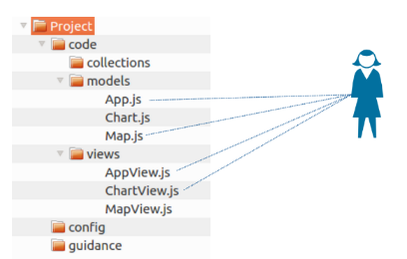
Three learning goals in three sessions
Session 1
Session 2
Session 3
Basic principles
Remote hosting
Team working

